Slide 1

Approximation Algorithms for NP-Hard Graph Problems
By Huzaifa Ahmad Awan

Slide 2
INTRODUCTION
„What should we do in this case?“
Recap:
There are a lot interesting problems defined in terms of graphs –
but turns out unfortunately many of
them are NP-hard.
Thus, unless P=NP there exists no efficient algorithms to find optimal solutions to such problems. But these problems aren’t just theoretical; they appear in the real World.
This presentation concerns itself with the awnser to the question

Slide 3
Optimization Problems
Optimization problems involve finding the best solution from a set of possible options, based on specific criteria or constraints. This most of the times means maximizing or minimizing something, like profit, cost, or time, while staying within certain limits.

Slide 4

What does it mean to solve a problem efficiently?

Slide 5
What does it mean to solve a problem efficiently?
Solve the problem in polynomial time
Solve arbitrary instances of the problem
Solve the problem to optimality
At least one of these requirements must be relaxed for NP-hard problems

Slide 6
WHAT ARE APPROXIMATION ALGORITHMS?
Definition:
An algorithm is an α-approximation algorithm if…
…it is guaranteed to run in polynomial time
…it is guaranteed to solve arbitrary instances of the problem
..it is guaranteed to find a solution that is within a factor of α of the value of an optimal solution

Slide 7

What is the factor α?
$$\text{α}\text{ = }\text{A}pproximation Ratio=\frac{C^{A}}{C^{∗}}$$
α>1 for minimizing problems
α<1 for maximization problem.
Examples:
A ½-approximation algorithm for a maximization problem is a polynomial-time algorithm that always returns a solution whose value is at least half of the optimal value.
A 1-approximation algorithm is one that produces the optimal solution

Slide 8

Minimum Vertex Cover

Slide 9

Minimum Vertex Cover
Given an undirected graph G=(V,E), a vertex cover is a subset of vertices C⊆V such that for every edge (u,v) ∈ E(u, v), at least one of u or v is in C. In other words, every edge in the graph is covered by at least one vertex in the set.

Slide 10
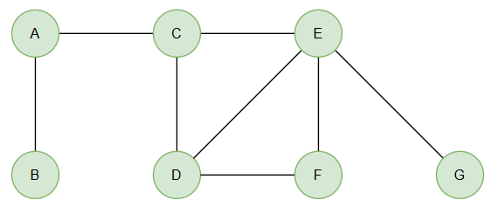
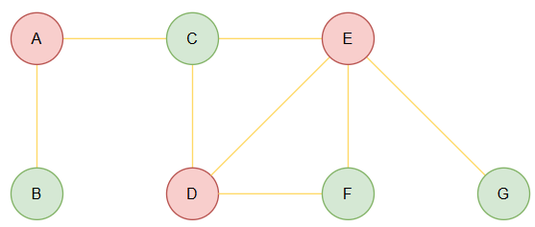



Minimum Vertex Cover
$$C^{∗}=\{A,D,E\}$$
Given a graph G(V,E):
Let $E′$= $E$, C={}
While $E′$ is nonempty:
Return C
Pick an edge (u,v) from $E′$ and add u & v to C
Remove any edge $E′$ that is connected to either u or v

Slide 11
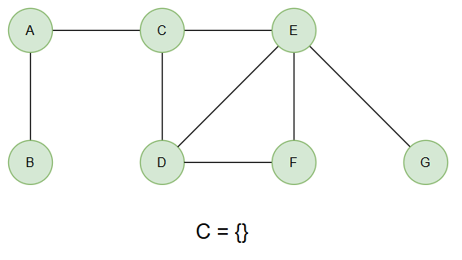
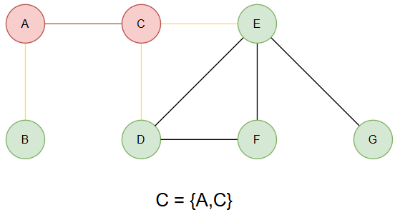
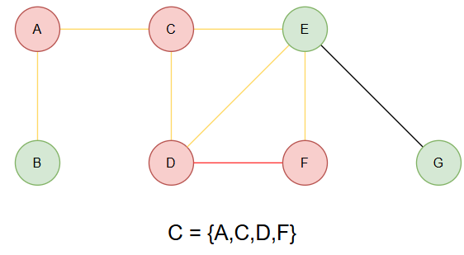
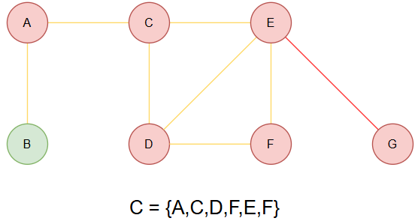
Example: Minimum Vertex Cover

Slide 12
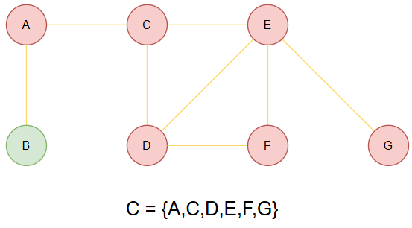

Example: Minimum Vertex Cover
$$C^{∗}=\{A,D,E\}$$

Slide 13
Minimum Vertex Cover: 2-Approximation Algorithm
We can show that this approximation is a 2-approximation algorithm, meaning that the solution it produces will not be worse than 2 times the optimal solution.
proof.

Slide 14

Minimum Vertex Cover: 2-Approximation Algorithm
Does it run in polynomial time?
Does it solve arbitrary instances?
Does it guarantee an approximation ratio?
3.Does it guarantee an approximation ratio?
Let M = set of edges selected in step 1 of each iteration (one edge per iteration).
Since we add both endpoints of each edge in M, the total number of vertices in the solution is:
$$\left|C^{A}\right|=2∗|M|$$
We notice no two edges in M share an endpoint, since once an edge (u,v) is selected, all edges incident to u or v are deleted
Thus, in any vertex cover (including $C^{∗}$) we must include at least on vertex for each edge on M. Therefore:
$$|C^{∗}|≥|M|$$
Putting both together we get:
$$\left|C^{A}\right|=2∗\left|M\right|≤2∗C^{∗}$$

Slide 15
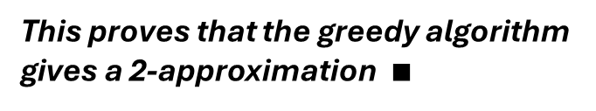
Minimum Vertex Cover: 2-Approximation Algorithm
.
Does it run in polynomial time?
Does it solve arbitrary instances?
Does it guarantee an approximation ratio?
Now the question is: Can we do better than 2? Could we design a 1.9-approximation or 1.5-approximation?
Well, here’s what research tells us:
Khot & Regev (2008)
Assuming the UGC is true:
No polynomial-time algorithm can do better than a 2-approximation for Vertex Cover
Dinur & Safra (2005)
They proved that it's NP-hard to approximate the Minimum Vertex Cover to within a factor better than ~1.36.
That sets a lower bound: no algorithm can achieve better than 1.36 unless P = NP.
This proves that the greedy algorithm gives a 2-approximation $∎$

Slide 16

Limitations of Approximation Algorithms
Limitations of Approximation
Algorithms

Slide 17

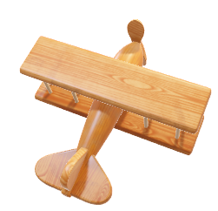
The Travelling Salesman (TSP)
Given a complete graph G=(V,E) with nonnegative edge weights, find a minimum cost cycle visiting every vertex exactly once.

Slide 18



The following has been proven:
For any $α>1$, there does not exist an $α$-approximation algorithm for the TSP on n cities, provided $P≠NP$.
How?
Lets assume there exists an $α$-approximation algorithm.
The Hamiltonian Cycle problem asks whether a given graph has a simple cycle that visits each vertex exactly once. To reduce it to TSP, we construct a complete graph where:
The original edges are assigned cost 1, and
The non-edges are assigned a cost $n+2$
Observe that if there is a tour of cost = $n$ in this TSP instance this corresponds exactly to a Hamiltonian cycle in the original graph.
And otherwise each tour costs at least 2n+1
The following has been proven:
THE END?

Slide 19

Metric TSP
A natural assumption to make about the input of the TSP is to restrict attention to those inputs that are metric; that is, for each triple I, j, k $∈V,$ the triangle inequality holds:
$$c_{ik}≤c_{ij}+c_{jk}$$
This assumption rules out the construction used in the reduction for the HC problem; the non-edges can be given cost at most 2 if we want the triangle inequality to hold, and this value is too small to yield a nontrivial non-approximability result.

Slide 20
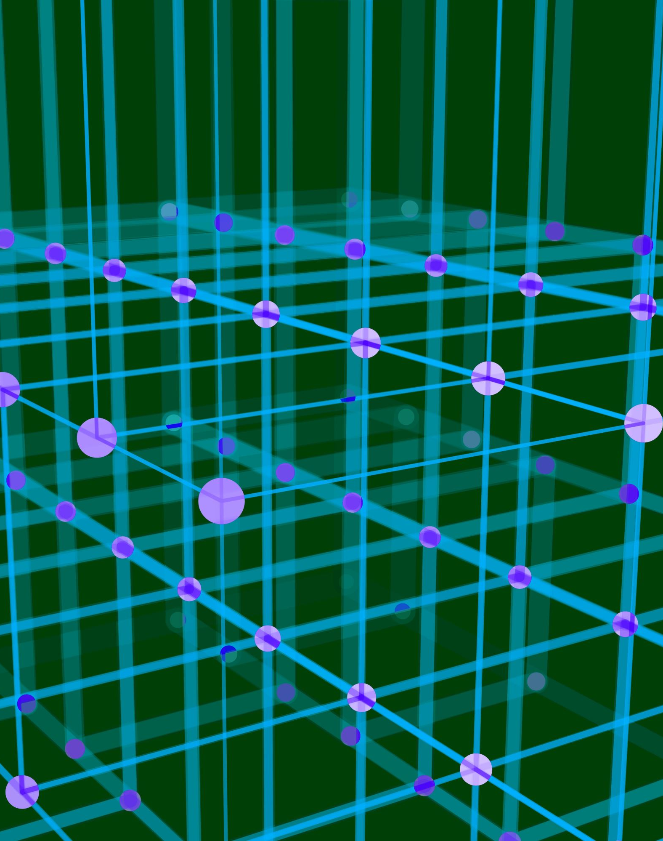
Christofides' Algorithm
Pseudocode
Find an MST of G, say T
Let O be the set of vertices with odd degree in T.
Find a minimum-cost perfect matching M. Add M to T and obtain an Eulerian graph.
Find a Eulerian tour
Shortcut the Eulerian tour to make a HC.

Slide 21
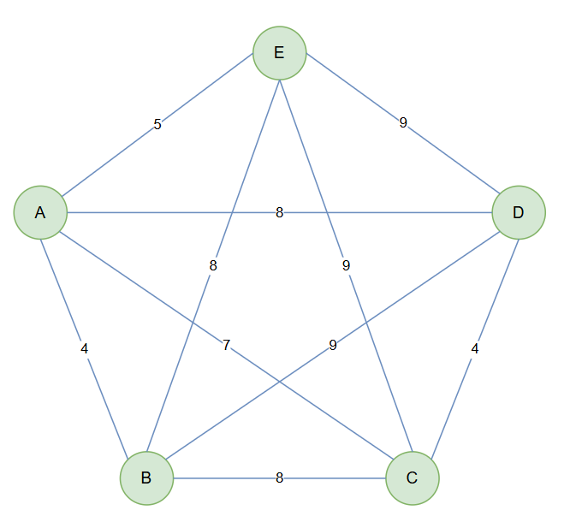
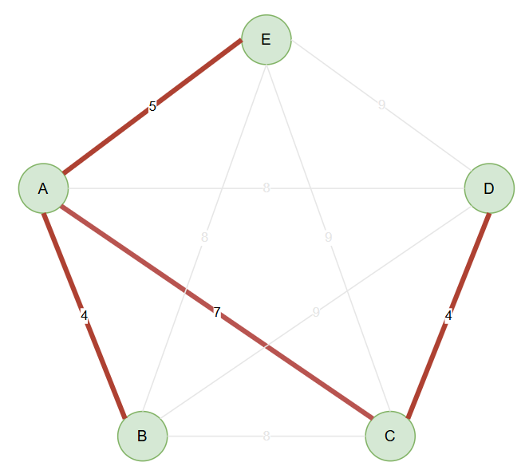
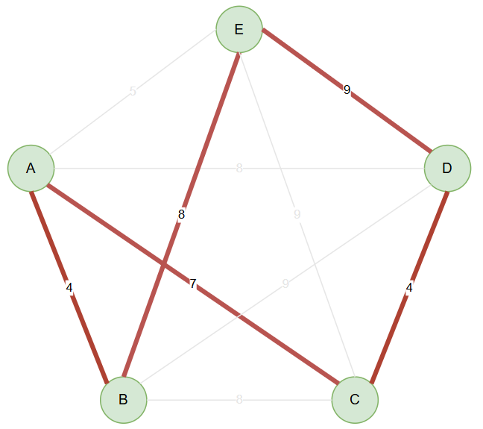
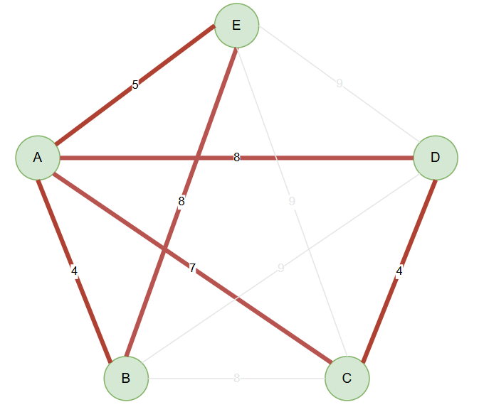
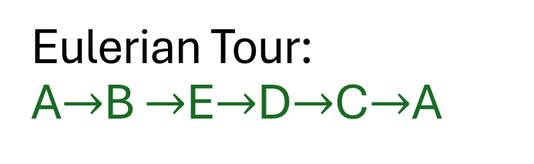
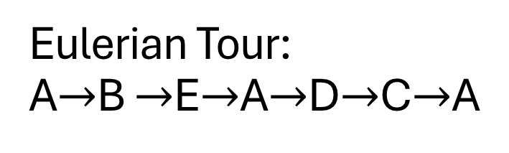
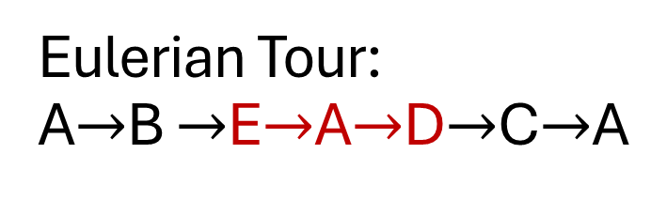
Tour cost: 4+8+9+4+7=32
5.
2.
4.
3.
1.
deg(A) = 2 (even)
deg(B) = 2 (even)
deg(C) = 2 (even)
deg(D) = 2 (even)
deg(E) = 2 (even)
deg(A) = 3 (odd)
deg(B) = 1 (odd)
deg(C) = 2 (even)
deg(D) = 1 (odd)
deg(E) = 1 (odd)
deg(A) = 3 (odd)
deg(B) = 1 (odd)
deg(C) = 2 (even)
deg(D) = 1 (odd)
deg(E) = 1 (odd)
Eulerian Tour:
A$→$B $→$E$→$A$→$D$→$C$→$A
Eulerian Tour:
A$→$B $→$E$→$A$→$D$→$C$→$A
Eulerian Tour:
A$→$B $→$E$→$D$→$C$→$A

Slide 22
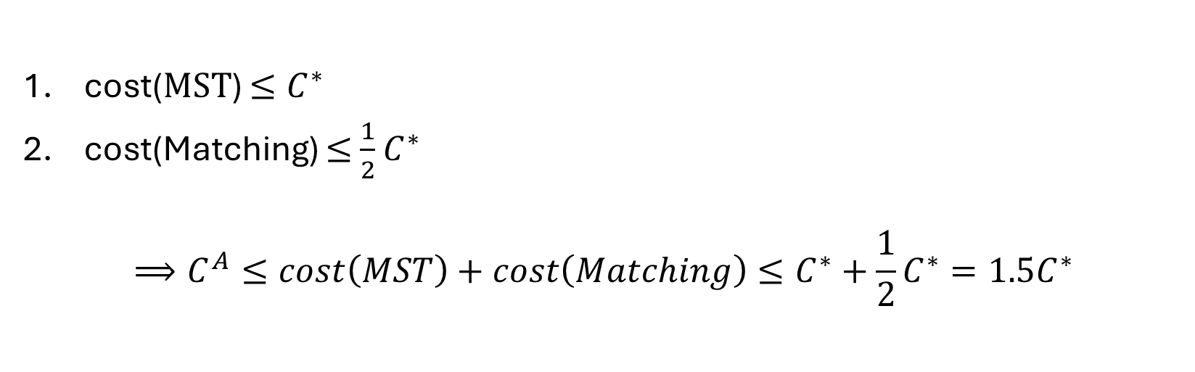
Approximation Ratio of Christofides' Algorithm
cost($MSΤ$) $≤C^{∗}$
cost(Matching) $≤$ $\frac{1}{2}$ $C^{∗}$
$$⟹C^{A}≤cost\left(MST\right)+cost\left(Matching\right)≤C^{∗}+\frac{1}{2}C^{∗}=1.5C^{∗}$$

Slide 23
Summary
Introduction: Approximation Algorithms as practical solutions for NP-hard problems that lack efficient optimal algorithms
Approximation Ratio: As a bound guarantee for the approximation
Minimum Vertex Cover – with a proven 2-approximation algorithm and limitations of Approximation
General TSP: Why we can not get an Approximation
Metric Traveling Salesman Problem (TSP):
Christofides' Algorithm, guarantees a solution no worse than 1.5 times the optimum.

Slide 24
REFRENCES „The Design of Approximation Algorithms“ by Willliamson & Shmoys „Approximation Algorithms“ by Vazirani

Slide 25

Q&A
Thank you for your Attention! Any Questions?

